Slide 1
Introduction
Paragraphs 구성
Photonic Integrated Circuits (PICs) based on Silicon-on-Insulator (SOI)에 대한 관심 증폭[1]
Integrated component에서 power splitter는 필수
“beyond 5G” generation에서 THz optical device의 중요성[2, 3]
THz optical device example: Subwavelength Graphene waveguide (30 THz)[4], Multi-output splitter without grating structure, Genetic Algorithm[5]
기존에는 analytically designed structure를 바탕으로 몇가지 parameters를 조절하는 방법으로 설계
Example: Direct Binary Search [6], self-imaging[7, 8, 9], sweep parameter based on specific structure[10]
제한된 설계 조건, Performance 한계
Splitter에서 1x3이상의 경우에는 complexity가 증가하여 설계가 어려움
최근 machine learning을 활용한 design 방법
Example: Alternating Directions Method of Multipliers (ADMM) optimization[11, 12, 13], Artificial Neural Networks [14, 15]
In this study,
Photonic Integrated Circuits review paper - L. Thylén and L. Wosinski, “Integrated photonics in the 21st century,” Photonics Research, vol. 2, no. 2, p. 75, Jan. 2014.
THz communication, 504 citation - I. F. Akyildiz, J. M. Jornet, and C. Han, “Terahertz band: Next frontier for wireless communications,” Physical Communication, vol. 12, pp. 16–32, 2014.
THz communication recent paper, arxiv 2019 - E. Calvanese Strinati et al., "6G: The Next Frontier: From Holographic Messaging to Artificial Intelligence Using Subterahertz and Visible Light Communication," in IEEE Vehicular Technology Magazine, vol. 14, no. 3, pp. 42-50, Sept. 2019
Subwavelength Graphene waveguide (30 THz) - Z. Guo, X. Nie, F. Shen, H. Zhou, Q. Zhou, J. Gao, and K. Guo, “Actively Tunable Terahertz Switches Based on Subwavelength Graphene Waveguide,” Nanomaterials, vol. 8, no. 9, p. 665, 2018.
Multi-output splitter without grating structure, Genetic Algorithm - F. Zhang, K. Song, and Y. Fan, “New 2D diffraction model and its applications to terahertz parallel-plate waveguide power splitters,” Scientific Reports, vol. 7, no. 1, Sep. 2017.
Direct Binary Search algorithm - L. Lu, M. Zhang, F. Zhou, and D. Liu, “An Ultra-compact Colorless 50:50 Coupler Based on PhC-like Metamaterial Structure,” Optical Fiber Communication Conference, 2016.
Self-imaging, NxN multimode - M. Bachmann, P. A. Besse, and H. Melchior, “General self-imaging properties in N × N multimode interference couplers including phase relations,” Applied Optics, vol. 33, no. 18, p. 3905, 1994.
Self-imaging, multimode, review - L. Soldano and E. Pennings, “Optical multi-mode interference devices based on self-imaging: principles and applications,” Journal of Lightwave Technology, vol. 13, no. 4, pp. 615–627, 1995.
Analytic method - Eigenmode decomposition theory - Y. Tian, J. Qiu, M. Yu, Z. Huang, Y. Qiao, Z. Dong, and J. Wu, “Broadband 1 × 3 Couplers With Variable Splitting Ratio Using Cascaded Step-Size MMI,” IEEE Photonics Journal, vol. 10, no. 3, pp. 1–8, 2018.
Butterfly geometry - P. Besse, E. Gini, M. Bachmann, and H. Melchior, “New 2×2 and 1×3 multimode interference couplers with free selection of power splitting ratios,” Journal of Lightwave Technology, vol. 14, no. 10, pp. 2286–2293, 1996.
Machine Learning_Alternating Directions Method of Multipliers (ADMM) optimization algorithm - A. Y. Piggott, J. Lu, K. G. Lagoudakis, J. Petykiewicz, T. M. Babinec, and J. Vučković, “Inverse design and demonstration of a compact and broadband on-chip wavelength demultiplexer,” Nature Photonics, vol. 9, no. 6, pp. 374–377, 2015.
Machine Learning_Alternating Directions Method of Multipliers (ADMM) optimization algorithm, T-shape Polarizatino Beamsplitter - Z. Ye, J. Qiu, C. Meng, L. Zheng, Z. Dong, and J. Wu, “Inverse Design of a SOI T-junction Polarization Beamsplitter,” Journal of Physics: Conference Series, vol. 844, p. 012009, 2017.
Machine Learning_Alternating Directions Method of Multipliers (ADMM) optimization algorithm - A. Y. Piggott, J. Petykiewicz, L. Su, and J. Vučković, “Fabrication-constrained nanophotonic inverse design,” Scientific Reports, vol. 7, no. 1, Nov. 2017.
Deep Learning_ResNet algorithm (without Convolutional Networks) - M. H. Tahersima, K. Kojima, T. Koike-Akino, D. Jha, B. Wang, C. Lin, and K. Parsons, “Deep Neural Network Inverse Design of Integrated Photonic Power Splitters,” Scientific Reports, vol. 9, no. 1, 2019.
Deep Learning_Covolutional Neural Network(CNN) algorithm - M. H. Tahersima, K. Kojima, T. Koike-Akino, D. Jha, B. Wang, C. Lin, and K. Parsons, “Nanostructured Photonic Power Splitter Design via Convolutional Neural Networks,” Conference on Lasers and Electro-Optics, 2019.

Slide 2
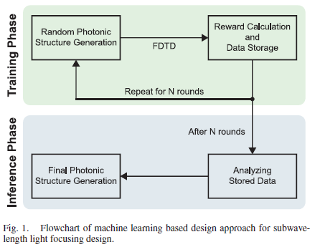
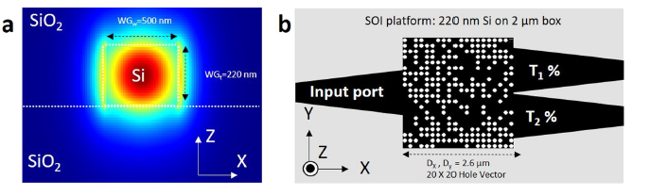
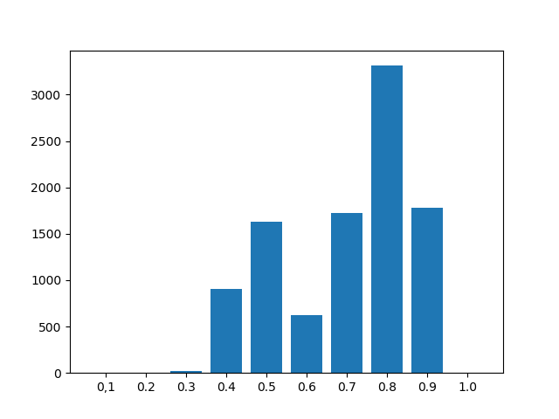
Method
Paragraphs 구성
Perceptron-like machine learning algorithm[16]
“The algorithm combines the additive updates feature of the perceptron algorithm and the reward for state idea of reinforcement learning”[17]
20 x 10 binary matrix
“1” for etched (air), “0” for not etched (Si)
Reward = min(T1) + min(T2) - R
Figure: Algorithm flowchart
integrated photonic 1x3 power splitter
SOI platform: 9 um radii, 20x20 air-hole on 500 um box
not aim to maximize the operation bandwidth, broadband transmission 275 ~ 325 um
1:1:1 uniform
Figure: Design base structure and condition
Generate labeled data for training phase
Commercially available software Lumerical FDTD solutions
Figure: Data transmission distribution
C. Latifoglu, “Binary matrix guessing problem,” Jan. 2017. [Online]. Available: arXiv: e-prints, vol.1701.06167
M. Turduev, E. Bor, C. Latifoglu, I. H. Giden, Y. S. Hanay, and H. Kurt, “Ultracompact Photonic Structure Design for Strong Light Confinement and Coupling Into Nanowaveguide,” Journal of Lightwave Technology, vol. 36, no. 14, pp. 2812–2819, 2018.

Slide 3
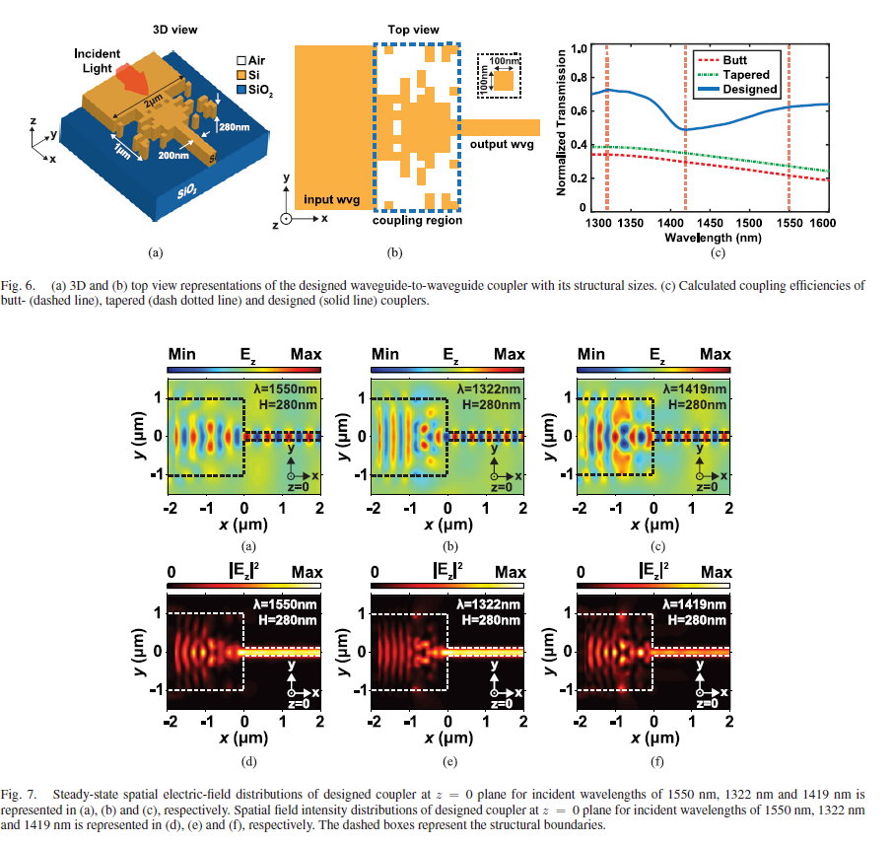
Result & Discussion
Paragraphs 구성
“The two key criteria for a power splitter are low insertion loss, and excellent power uniformity.”[11]
Figure: design result (structure, spectrum, power distribution)

Slide 4
Machine Learning과 Deep Learning의 관계
Artificial Intelligence
Machine Learning
Deep Learning
Machine Learning:
Machine Learning is the study of computer algorithms that improve automatically through experience.
Deep Learning:
Deep learning is a particular kind of machine learning that achieves great power and flexibility by learning to represent the world as nested hierarchy of concepts, with each concept defined in relation to simpler concepts, and more abstract representations computed in terms of less abstract ones
Machine Learning definition
T. M. Mitchell, Machine Learning. New York: McGraw-Hill, 1997.
Deep Learning categorization review
Y. Lecun, Y. Bengio, and G. Hinton, “Deep learning,” Nature, vol. 521, no. 7553, pp. 436–444, 2015.

